Slide 1

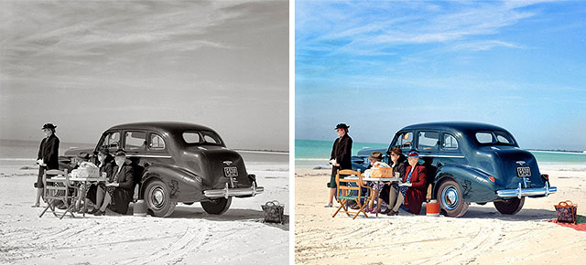
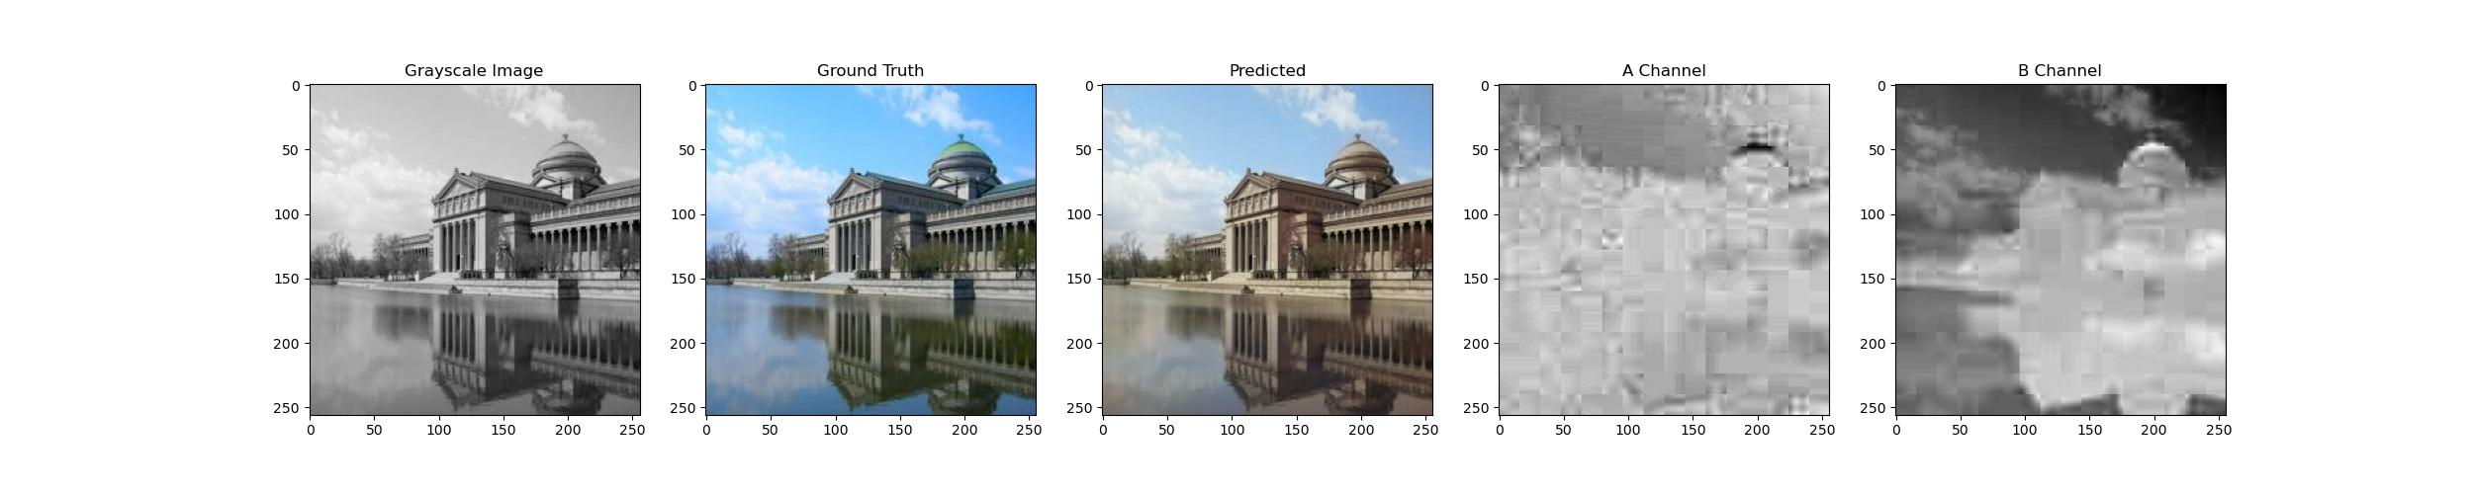
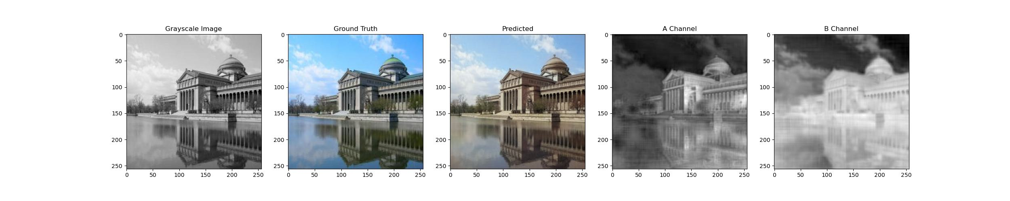
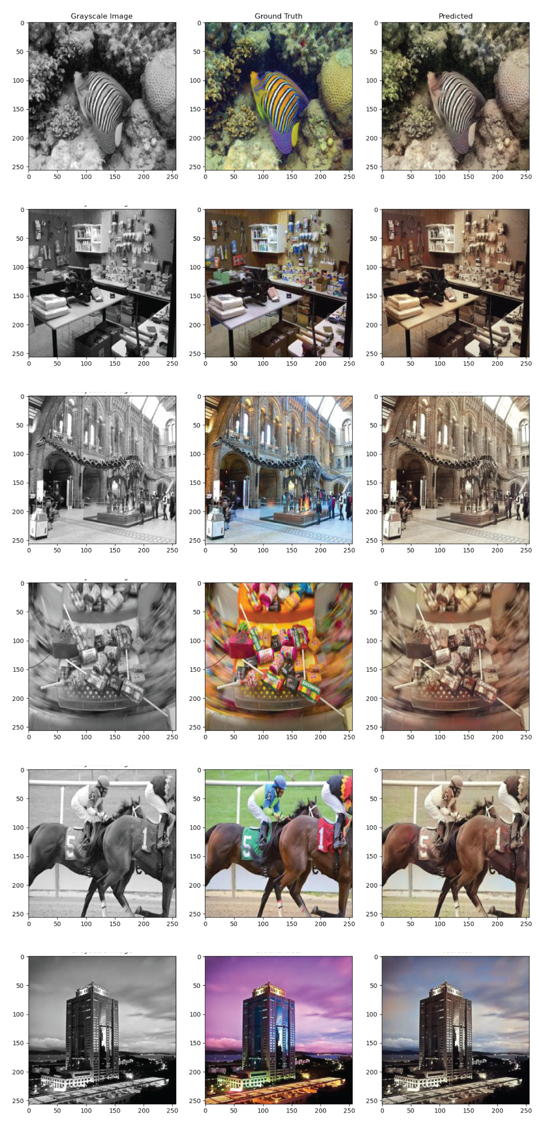
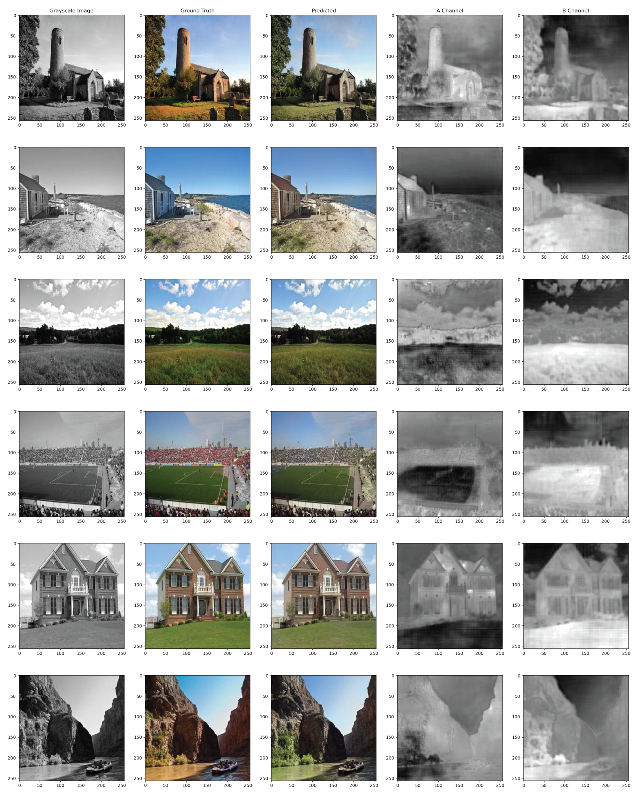
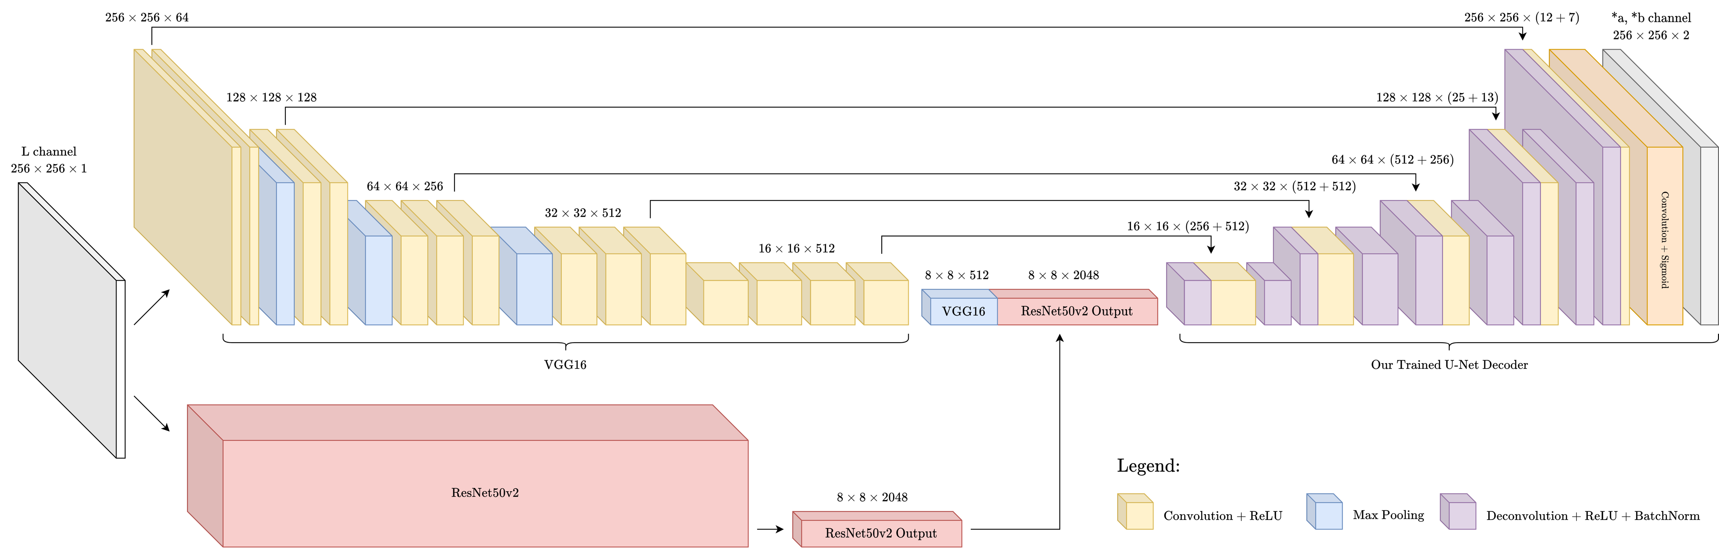
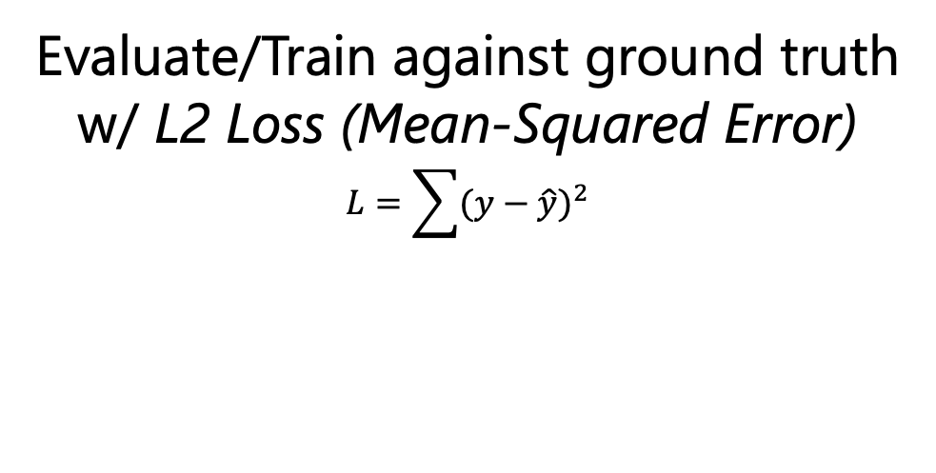
Restoring B+W Photos: Image Colorization with Hybrid U-Net
Jiahua Chen, Kathy Li, Sreshtaa Rajesh, Kiara Vong
Motivation
Datasets
Training Optimizations
Image recolorization benefits:
Restoring old art and/or historic artifacts
Highlighting different features in images (think medical imaging)
Applications in photo editing, data augmentation
Finally… it’s cool!
Before [cite]
Due to the fact that we used a number of pre-trained networks in our model architecture, parts of our CNN were trained on the following datasets.
State Goals
Do X. Blah blah blah.
Do Y. Blah blah blah.
Training:
VGG: ImageNet
ResNet: ImageNet
Custom head: MIT Places2 test dataset*
Testing:
MIT Places2 validation dataset*
After [cite]
* Note: we used the test dataset for our training because the training dataset was too large to feasibly run on our resources
Results: Good and Bad
How it works
Good:
Landscapes, Homes, Sky, Greenery
Bad:
Patterns, Objects, Warm/Cool Colors, Artifacts
L
Grayscale
Our Model
Predicted *a
Red-Green
*a
Red-Green
Original Image
(RGB)
Evaluate/Train against ground truth
w/ L2 Loss (Mean-Squared Error)
$$L=\sum{{(y−\hat{y})}^{2}}$$
Predicted *b
Yellow-Blue
Colorized Image
(RGB)
*b
Yellow-Blue
(Unintended Side-Effect: our model produces outputs with more color detail than compressed original image!)
Model Architecture: U-Net with VGG16 & ResNet50v2 Backbone
Pretrained VGG16 and ResNet50v2 encoders for rich (high-dimensional) feature tensor.
Trained U-Net decoder: deconvolution + concatenation from appropriately-sized VGG16 convolution tensors.
References
Acknowledgements
[1] Xiang, Yu et al. “PoseCNN: A Convolutional Neural Network for 6D Object Pose Estimation in Cluttered Scenes.” CoRR abs/1711.00199 (2018): n. pag.
[2] S. Gupta, P. Arbela ́ez, R. Girshick, and J. Malik. Aligning 3d models to RGB-D images of cluttered scenes. In Proc. Of CVPR 2015.
[3] A. X. Chang, T. Funkhouser, L. Guibas, P. Hanrahan, Q. Huang, Z. Li, S. Savarese, M. Savva, S. Song, H. Su, et al. Shapenet: An information-rich 3d model repository. arXiv:1512.03012, 2015.
We would like to thank…

